Slide 1
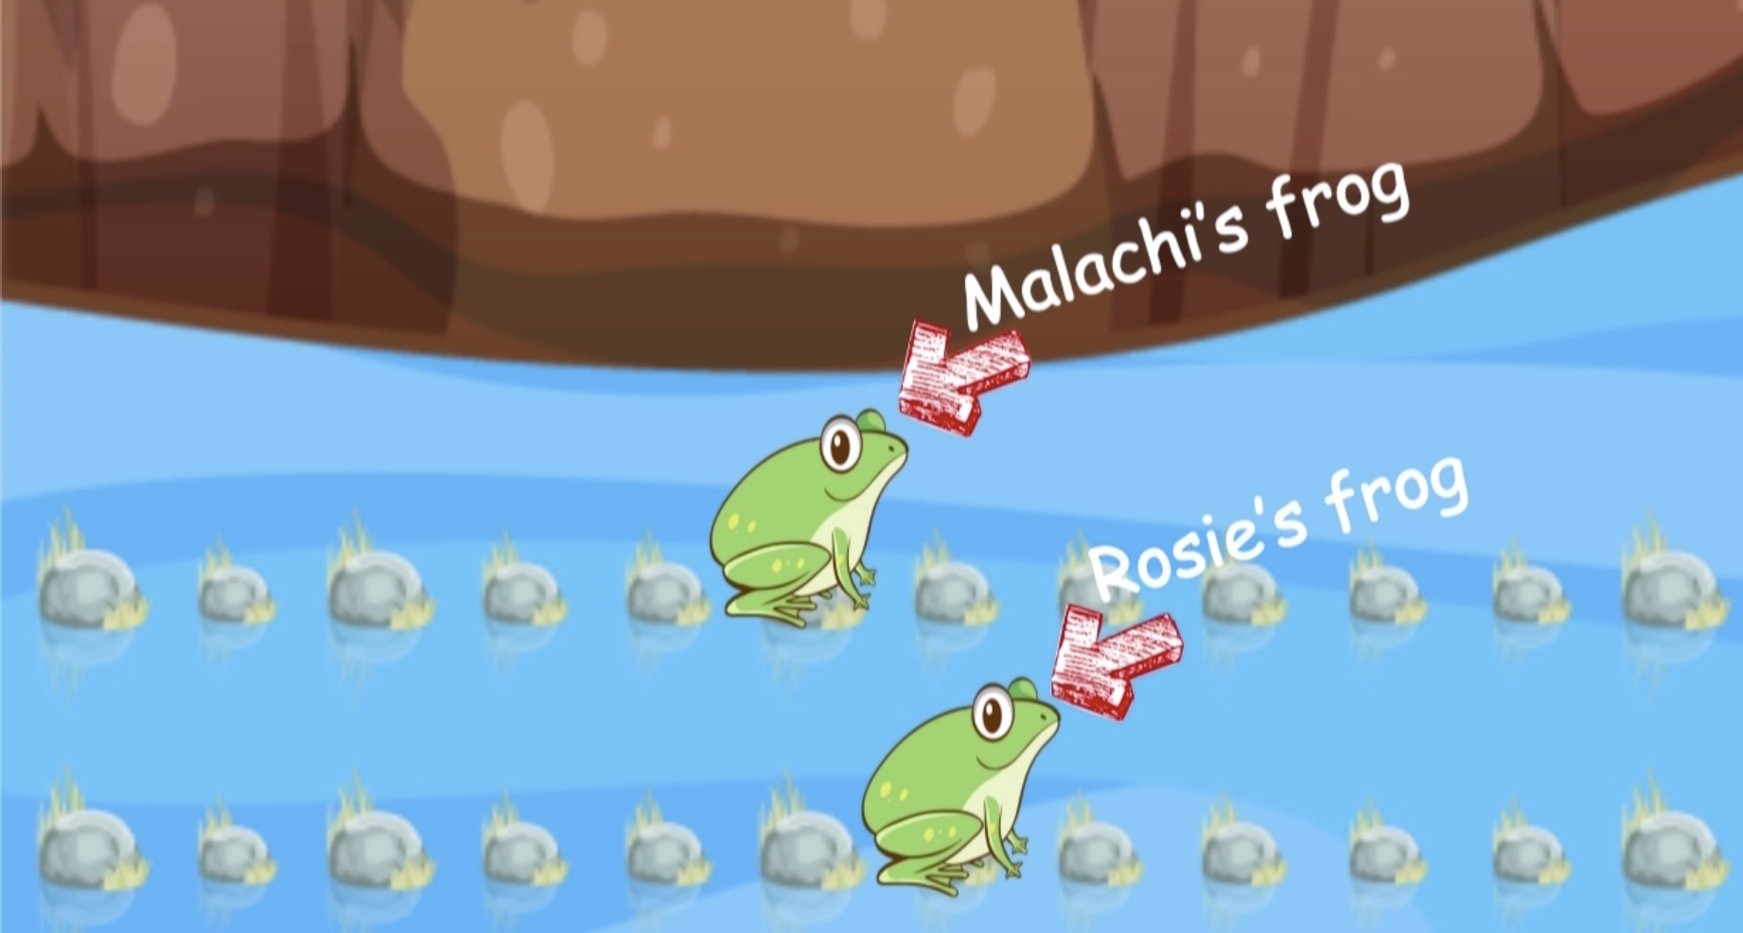

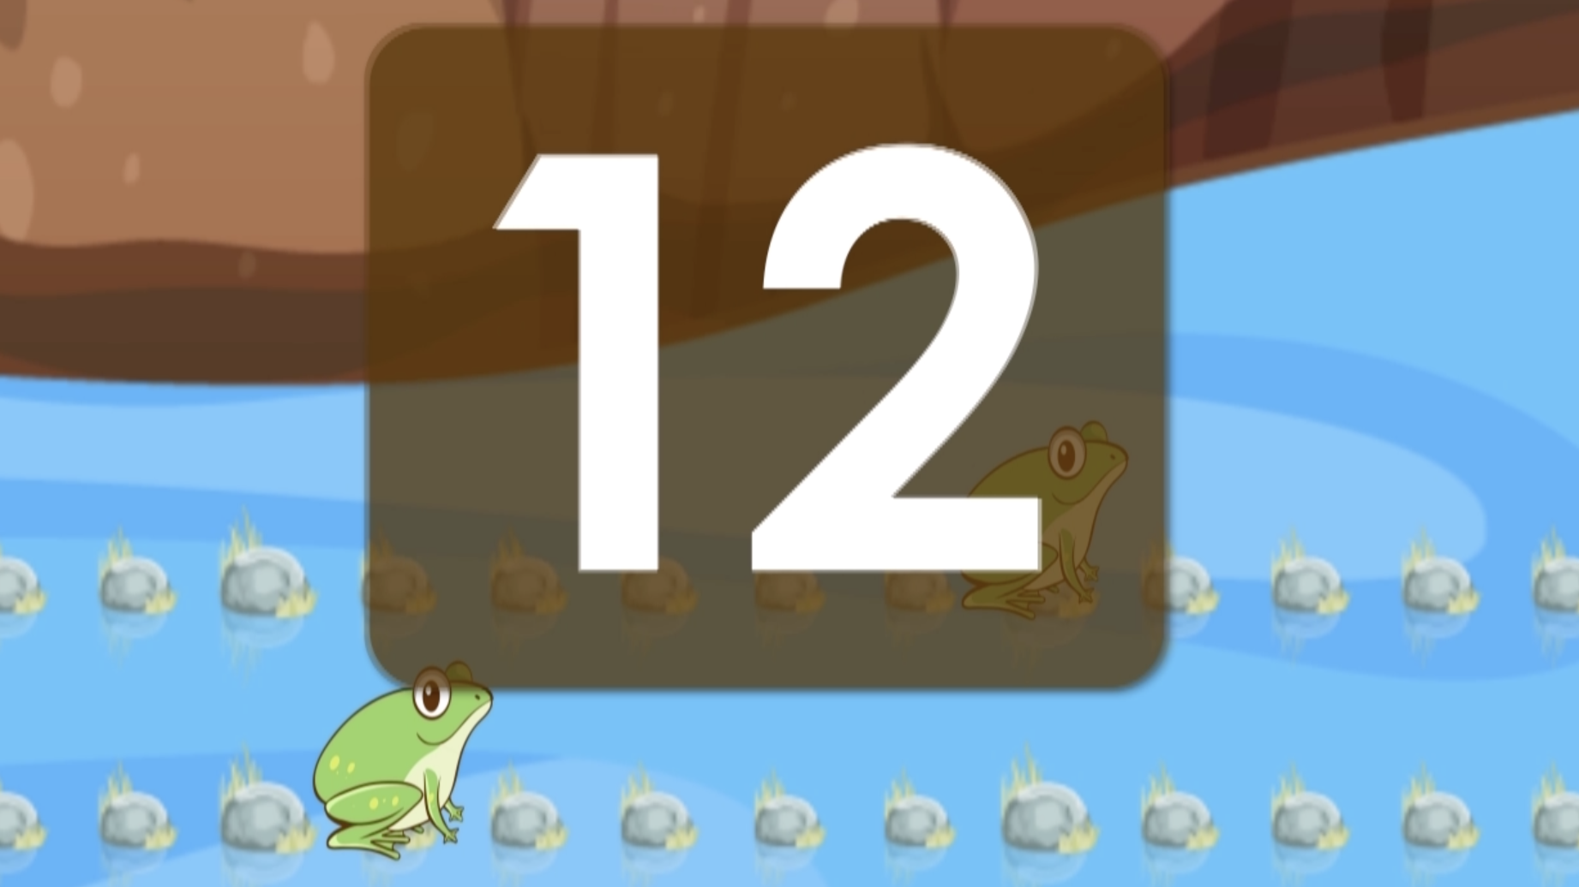
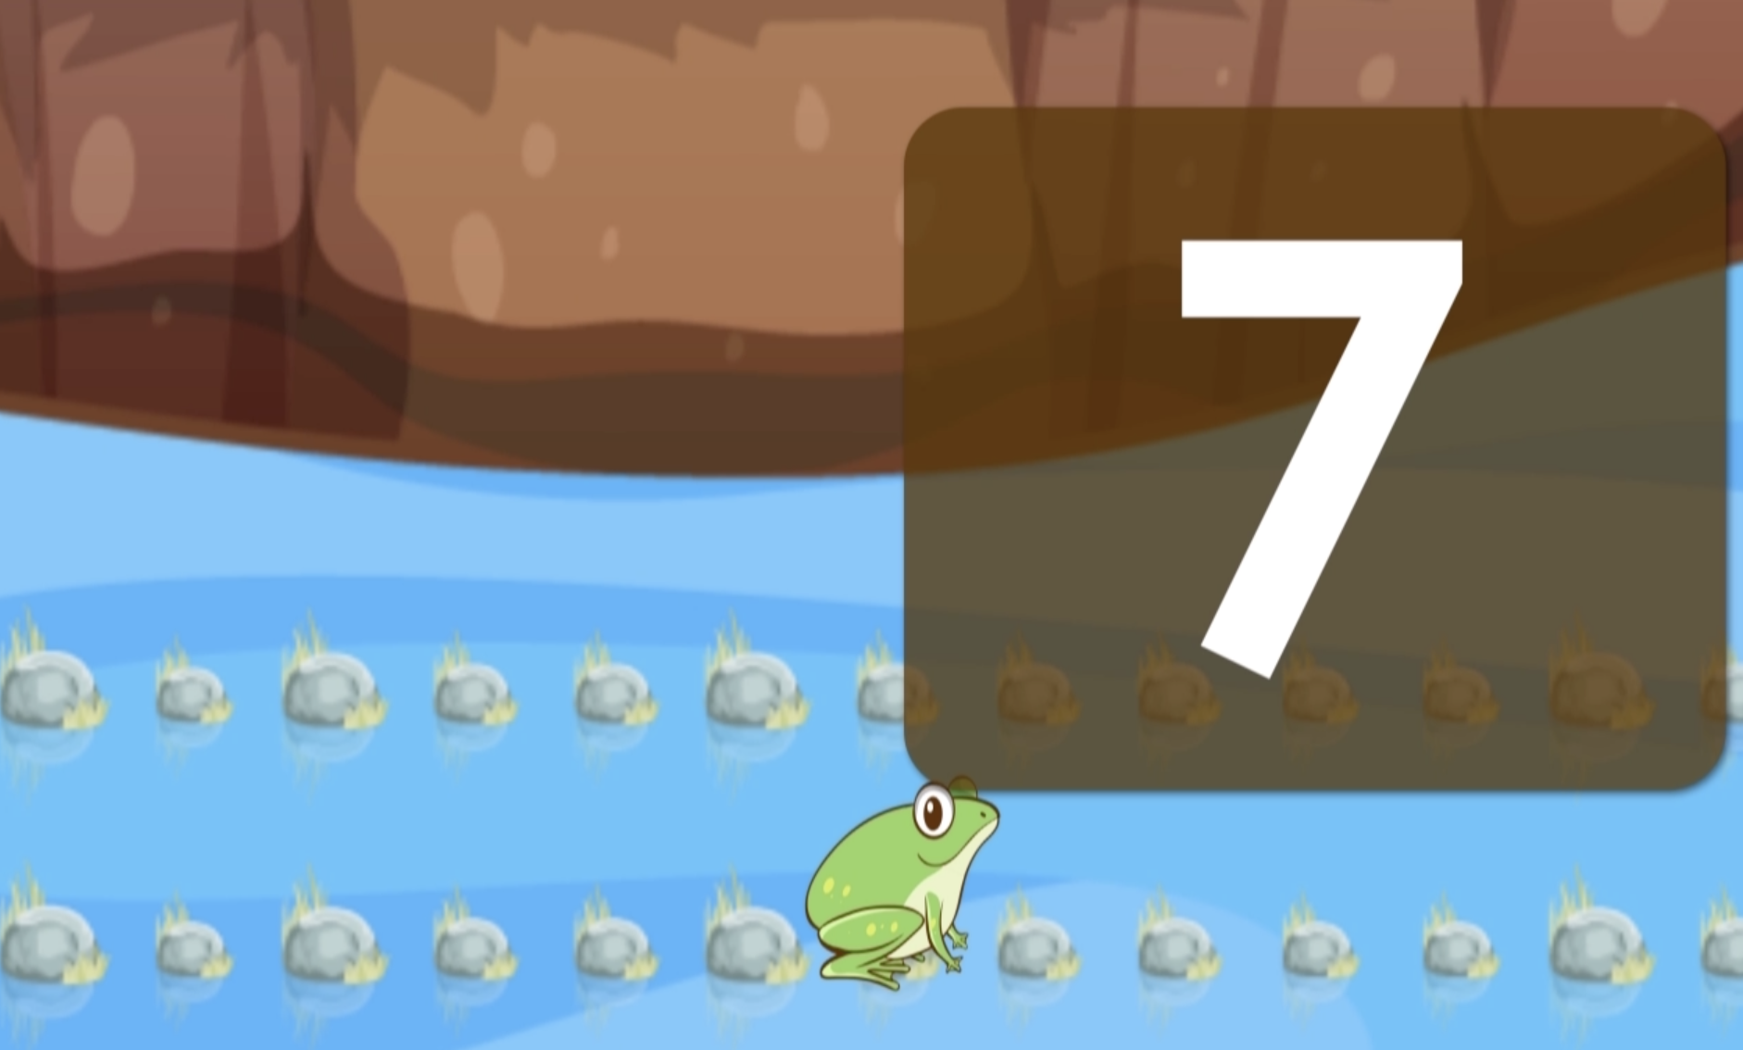
Plenary Video – Year 4: Count in multiples of 6 and 7
Introduction These videos are designed to be interactive. Children will need a whiteboard and pen, or a piece of paper and a pencil to write down numbers. You will be told when to pause the video in order for children to work out the answers and also to discuss questions asked. You can also take it at your own pace and pause when necessary.
This video covers the Year 4 Objective: Count in multiples of 6 and 7 Explain to the children that they are going to watch a video that will help them practise counting in 6s and 7s. There may be some children who are not confident in counting in 6s and 7s yet, these children could have a 100 square grid where they have coloured in the multiples of 6 and 7.
 |  | Children’s activity
Start | Play video for children.
30 seconds | The video can be paused here if you choose. Can you count and check that the frogs are in the right position? Tell the children they can write 6 on their whiteboard and 7 on the bottom half. This is where they will be counting in multiples of 6s and 7s and writing them down. | Children can write the number 6 at the top of their whiteboard and the number 7 on the bottom half of their whiteboard.
34 seconds | Malachi’s frog will start to jump on every 6th rock and will give the children a chance to say or write their number down on a whiteboard. | Children are to say or write the next number that they think will come up.
1 minute and 1 second | Rosie’s frog will now jump and the children will count in 7s. | Children are to say or write the next number that they think will come up.

Slide 2
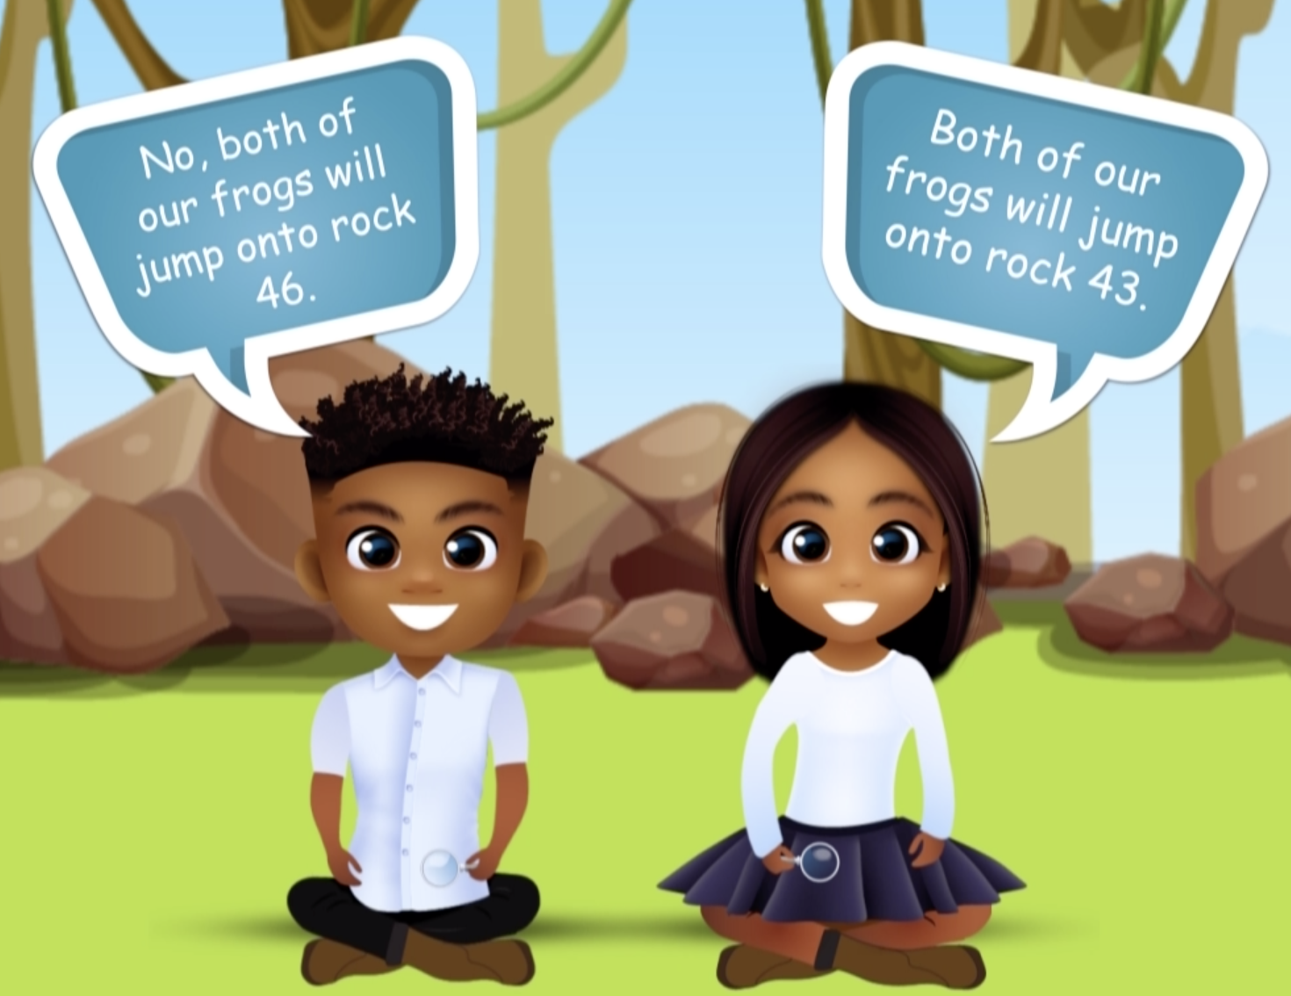
Plenary Video – Year 4: Count in multiples of 6 and 7
 |  | Children’s activity
1 minute and 24 seconds | Reasoning: The children are introduced to a statement from Rosie saying that both frogs will jump onto rock 43. Malachi disagrees and says it is rock 46. Who do the children agree with and why? The video is to be paused to allow the children to discuss. | Children to discuss with a talk partner or in groups about who they think is correct. Ask children what they will do to work out who is correct.
1 minute and 42 seconds | The answer is revealed that neither children are correct as both frogs jump on the number 42.
1 minute and 57 seconds | Another reasoning question is posed to the children- do they think there is another number both frogs will jump on? The video needs to be paused again so the children can discuss. Tell children to write their answers on a whiteboard and to not reveal it yet. | Children to discuss with a talk partner or in groups about whether there is another number both frogs will land on.
2 minutes and 2 seconds | The answer is revealed and the number is 84. Did the children get it right? What did they do to work this out?
2 minutes and 10 seconds | The video then continues with each frog jumping to the number 84. | Children to count along in 6s and 7s.

Slide 3
Plenary Video – Year 4: Count in multiples of 6 and 7
 |  | Children’s activity
3 minutes and 10 seconds | A question is posed: How many times did Rosie’s frog have to jump to reach this number? Pause the video so the children can work out how many jumps were needed to reach the number 84. Can children use their times tables to help answer the question? | Children to work out how many jumps Rosie’s frog will need to jump to reach 84.
3 minutes and 25 seconds | The answer is revealed that it is 12 times.
3 minutes and 34 seconds | The children now need to work out how many times Malachi’s frog jumped to reach the number 84. Video to be paused. | Children to work out how many jumps Tia’s frog will need to jump to reach 84.
3 minutes and 52 seconds | The answer is revealed that it is 14 times. The children can count along with the multiples displayed at the top of the screen.
4 minutes and 21 seconds | Video finishes. Can children count in 6s and 7s independently? Let them practise and recite.

